Slide 1
Driver Drowsiness Detection Using OpenCV and dlib
180030374 – T.Mani Shankar
180030271 – Sai Sowri Vikas

Slide 2
Problem Statement….? - In this project, we are going to build a model that will detect if the eyes of the driver are close for too long and infer if the driver is sleepy or inactive. - This can be an important safety implementation as studies suggest that accidents due to drivers getting drowsy or sleepy account for around 20% of all accidents and on certain long journey roads it’s up to 50%. It is a serious issue and most people that have driven for long hours at night can relate to the fact that fatigue and slight brief state of unconsciousness can happen to anyone and everyone. - There has been an increase in safety systems in cars & other vehicles and many are now mandatory in vehicles, but all of them cannot help if a driver falls asleep behind the wheel even for a brief moment.

Slide 3
Solution … Hence we are gonna build = Driver Drowsiness Detection System with alarm

Slide 4
Literature Survey :- [1] Hemant Kumar Dua , Sanchit Goel , Vishal Sharma,” Drowsiness Detection and Alert System”, IEEE International Conference on Advances in Computing, Communication Control and Networking, 2018, DOI: 10.1109/ICACCCN.2018.8748448 [2] Jang Woon Baek, Byung-Gil Han, Kwang-Ju Kim, Yun-Su Chung, Soo-In Lee,” Real-time Drowsiness Detection Algorithm for Driver State Monitoring Systems”, IEEE Electronics and Telecommunications Research Institute, 2018, DOI: 10.1109/ICUFN.2018.8436988 [3] Wisaroot Tipprasert, Theekapun Charoenpong, Chamaporn Chianrabutra, Chamaiporn Sukjamsri,” A Method of Driver’s Eyes Closure and Yawning Detection for Drowsiness Analysis by Infrared Camera”, IEEE First International Symposium on Instrumentation, Control, Artificial Intelligence, and Robotics (ICA-SYMP),2019, DOI: 10.1109/ICA-SYMP.2019.8646001

Slide 5
[4] Kumar A., & Patra R,”Driver drowsiness monitoring system using visual behaviour and machine learning”,IEEE Symposium on Computer Applications & Industrial Electronics (ISCAIE),2018, DOI: 10.1109/ISCAIE.2018.8405495 [5] C. Kublbeck and A. Ernst, “Face detection and tracking in video sequence using the modified census transformation,” Image and Vision Computing, Vol. 24, pp. 564-572, 2006 [6] K. Ban, J. Kim, and H. Yoon, “Gender Classification of Low- Resolution Facial Image Based on Pixel Classifier Boosting,” ETRI Journal vol.38, no. 2, pp. 347-355. Apr. 2016. [7] P. Viola and M. Jones, "Rapid object detection using a boosted cascade of simple features," Proceedings of the 2001 IEEE Computer Society Conference on Computer Vision and Pattern Recognition. CVPR 2001, Kauai, HI, USA, 2001, pp. I-I [8] N. Dalal and B. Triggs, “Histograms of Oriented Gradients for Human Detection”, IEEE conf. on CVPR, 2005

Slide 6
Methods & Techniques Available There are many techniques available for approaching this problem and each has its sets of pros and cons. We are gonna list some and then infer why we chose one for our use. EEG based :- Electroencephalogram (EEG) signal of driver measured with a single electrode neuro-signal acquisition device and a fatigue index or activity level calculated which in turn tells if the driver is likely to fall asleep. This is a wearable type system. It is fairly robust but has to be specifically tuned for different individuals in some cases. Steering mounted :- It works by recording the steering behavior of the driver at different points in the trip and infer the level of activity of driver. It is often used in conjunction with monitoring different behaviors such as pressure on the acceleration pedal, movement of the car, etc.

Slide 7
Yawning based :- Video feed of the driver’s face is continuously scanned for gestures such as yawning which indicates fatigue state of the driver. A small camera placed inside the vehicle which records the behavior of the driver and the feed is either locally or over a server scanned for yawning and such behavior. Eyeblink measurement :- Similar to yawning-based method a camera records the driver’s face and checks if the driver’s eyes are closed or open. The estimated average blinking duration is between 100-400ms according to the Harward database of useful biological numbers. If the camera sees that the eye of the driver closes for a duration far more than that it marks the driver as asleep and some sort of alarm raised. - This method has proven to be the most effective measure and easiest to implement providing satisfactory results. Hence we are going to be using the same for our project, along with yawning measurement.

Slide 8
The libraries need for driver drowsiness detection system are Opencv Dlib Numpy These are the only packages you will need for this machine learning project.

Slide 9
Breif about Libraries :- -Numpy is used for handling the data from dlib and mathematical functions. Opencv will help us in gathering the frames from the webcam and writing over them and also displaying the resultant frames. -Dlib to extract features from the face and predict the landmark using its pre-trained face landmark detector. -Dlib is an open source toolkit written in c++ that has a variety of machine learning models implemented and optimized. Preference is given to dlib over other libraries and training your own model because it is fairly accurate, fast, well documented, and available for academic, research, and even commercial use. -Dlib’s accuracy and speed are comparable with the most state-of-the-art neural networks, and it beats them all in regard of all the activities

Slide 10
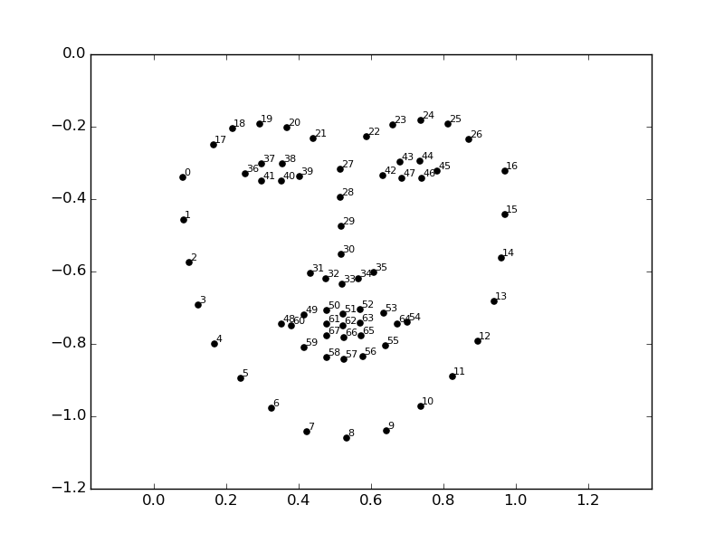
Facial LandMarks :-

Slide 11
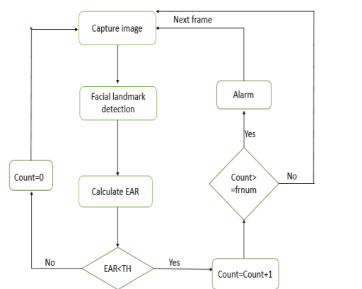
Work Flow :-

Slide 12
Modules include :- 1.Import Libraries. 2. Dlib’s face and facial landmark predictors. 3. Create a function for calculating the blinking ratio. 4.Create a function for calculating mouth aspect ratio. 5. Begin processing of frames.

Slide 13
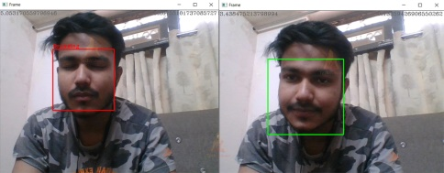
Yoo…!! Driver Drowsiness Detection Output :- Along with the alarm , image is the output

Slide 14
Summary :- we have successfully created driver drowsiness detector, we can implement it in other projects like computer vision, self-driving cars, drive safety, etc. Real Time Application :- Driver drowsiness project can be used with a raspberry pie to create a standalone system for drivers, used as a web service, or installed in workplaces to monitor employees’ activity. The sensitivity and the number of frames can be changed according to the requirements.

